Slide 1
Securing Our Digital Futures
Defence Cyber Training SLO 1.1.1 Apply Digital Analysis
Describe Incident Response, Policy and Governance
Notes:
1

Slide 2
Important Disclaimer
This course is aimed at teaching the technical skills required to conduct incident analysis and triage.
It is expected that all participants will be compliant with all legal, ethical and policy frameworks set forth within Defence.
This course will teach technical skills and demonstrate tools that have the potential to be misused. If any of the skills or techniques presented in this course conflict with Defence policy, it is up to the learner to research and adhere to their obligations under the relevant Defence policies.
Notes:
Important points to get across:
We are not ADF personnel, we are here as experts in cyber security.
Some of the tools and skills we will teach may be misused.
Misuse can carry harsh penalties – don’t do it.
Every participant in this course will need to ensure they are compliant with ADF rules and policies.
Explain the context of the legal, ethical and policy training for the following two days:
“The first two days especially, while covering legal and ethical issues, are not ADF specific. They are intended to give you a broad understanding of legal and ethical issues so that you have a full and rounded learning experience similar to those offered in Edith Cowan University’s Cyber Security Courses.
Day 1 will include hypothetical scenarios that may apply in an ADF environment which will allow learners to explore complex legal and ethical issues with respect to ADF rules and policies.
2

Slide 3
Overview of SLO 1.1.1
Describe Incident Response Policy and Governance
Day 1 Morning Legal Aspects ADF, Ethics and WoG Day 1 Afternoon Information Technology vs. Operational technology (IT & OT) Scenarios Reflection and Quiz | Day 2 Morning Incident Response Scenarios Day 2 Afternoon Incident Response cont.
Notes:
This module covers the important topic of policy and governance.
Day 1 is Incident Response, Ethical Issues, Whole of Government Capability.
The first presentation will be centred around the legal aspects
This is followed by a presentation on ethics.
Day one is concluded with a presentation of IT&OT
Structure for the day:
There will be 2 short (30 minute) presentations followed by an activities or group based scenarios
Day 2 is all about Incident Response. You will cover the incident response process and how to ‘think’ when you’re approaching an incident.
3

Slide 4
Legal Aspects - Contents
Overview - Presentation 1
Key Information Sources
The Law
Treaties
Relevant Laws and how they apply - The Crimes Act - The Privacy Act - The Criminal Code - The Telecommunications Act - The Cyber Crime Act - The Security of Critical Infrastructure Act
Evidence Gathering
Mandatory Reporting of a Data Breach
Notes:
These are the topics that will be covered in this presentation.
4

Slide 5



Key Information Sources
Australian Laws and Regulations
ACSC Australian Cyber Security Centre
This centre is part of ASD, and runs the JCSC in most capital cities.
National Institute of Standards and Technology
This is an American Standards body that is widely referred to
in the Cyber Industry. The NIST Standard 800 Series documentation
has been used as a blueprint for security and incident response.
Notes:
Australian Laws and Regulations:
The TIA Act protects the privacy of Australians by prohibiting interception of communications and access to stored communications. The privacy of Australians is also protected by the Telecommunications Act 1997, which prohibits telecommunications service providers from disclosing information about their customers' use of telecommunications services.
The Privacy Act 1988 (Privacy Act) is the principal piece of Australian legislation protecting the handling of personal information about individuals. This includes the collection, use, storage and disclosure of personal information in the federal public sector and in the private sector.
ACSC:
The Essential Eight has been designed to protect organisations’ internet-connected information technology networks. While the principles behind the Essential Eight may be applied to enterprise mobility and operational technology networks, it was not designed for such purposes and alternative mitigation strategies may be more appropriate to defend against unique cyber threats to these environments.
The Australian Signals Directorate produces the Information Security Manual (ISM). The ISM is a cyber security framework that an organisation can apply, using their risk management framework, to protect their information technology and operational technology systems, applications and data from cyber threats. The ISM is intended for Chief Information Security Officers, Chief Information Officers, cyber security professionals and information technology managers.
NIST:
NIST CSWP 29 The NIST Cybersecurity Framework (CSF) 2.0
February 26, 2024
i
Abstract
The NIST Cybersecurity Framework (CSF) 2.0 provides guidance to industry, government
agencies, and other organizations to manage cybersecurity risks. It offers a taxonomy of high-
level cybersecurity outcomes that can be used by any organization — regardless of its size,
sector, or maturity — to better understand, assess, prioritize, and communicate its
cybersecurity efforts. The CSF does not prescribe how outcomes should be achieved. Rather, it
links to online resources that provide additional guidance on practices and controls that could
be used to achieve those outcomes. This document describes CSF 2.0, its components, and
some of the many ways that it can be used

Slide 6

General Marcus Thompson
“There is nothing new in cyber warfare; what it requires is the application of old or established military methods in a new warfighting environment. The ADF must understand, and become masters of, the information environment.”
- Major General Marcus Thompson, Former Head of Information Warfare, Australian Defence Force Headquarters, November 2017
Notes:
This is a famous quote from General Marcus Thompson, former head of Information Warfare ADF
6

Slide 7
The Law
Civil and Criminal considerations
Application of law depends on jurisdiction in which an alleged offense is committed
May include state/territory, federal or international laws and Conventions
Jurisdiction
State: Section 192B of the Crimes Act (NSW)
Federal: Australian Cybercrime Bill
International: Budapest Convention on Cybercrime
Notes:
Every country’s constitution enforces certain laws, for the purpose of maintaining order and protecting the society from crimes. These laws are broadly classified into two categories, i.e., Civil Law and Criminal Law.
Civil law lays emphasis on resolving the dispute like family dispute, rent matters, disputes relating to the sale of land and so forth.
Criminal law stresses on punishment to the offender, who breaches the law by acts such as, murder, rape, theft, and smuggling, etc.
Civil law plays a crucial role, as it resolves most of the private matters, that happen to individuals. Conversely, the criminal law holds dominating positions with respect to national security interests and control/government departments and agencies - as it is a powerful tool which is used to protect the public interest against anti-social conduct.
In Australia, there are two key legal systems. The Commonwealth system and State-Territory system which impact cyber security. We will be focusing mainly on the Federal system since the ADF is a Federal body.
There is also international law which must be adhered to.
Difference Between Civil Law and Criminal Law (with Comparison Chart) - Key Differences
7

Slide 8
Rule of Law
Equality
before the law
The Australian Legal System Principles
Equal before the law
Right to fair hearing
Judiciary: independent and impartial
Right to a reasonable appeal
Checks and balances
on the use of power
Rights of the accused and victims
Presumption of innocence
Independence of the Judiciary
Right to assemble
Freedom of speech
Access to justice
Knowing the Law

Slide 9
Treaties – Our International Obligations
In additional to local, state and federal laws, Australia is also bound by treaty and international convention obligations.
When responding to a use of force, Australia considers that the thresholds and limitations governing the exercise of self-defence under Article 51 of the UN Charter, also apply to cyber operations that constitute an armed attack and in respect of acts of self-defence that are carried out by cyber means.
https://www.dfat.gov.au/sites/default/files/how-australia-implements-the-ungge-norms.pdf
Notes:
This slide is background legal information.
Article 51 gives nation states such as Australia the right to take offensive action against third parties.
Treaties
Australia is a member of several international treaties and obligations.
Australia utilises Article 51 (under Chapter 7: Action with Respect to Threats to the Peace, Breaches of Peace, and Acts of Aggression) under the UN Charter to stop or defence against Cyber Attacks.
Thus, if a cyber operation – alone or in combination with a physical operation – results in, or presents an imminent threat of, damage equivalent to a traditional armed attack, then the inherent right to self-defence is engaged (see, e.g.: 2019 International Law Supplement). Australia has also made public statements explaining it’s position on the concept of imminence and the right of self-defence in the context of national security threats that have evolved as a result of technological advances (i.e., cyber security/information warfare threats).
Australia acceded to the Council of Europe Convention on Cybercrime (the Budapest Convention) in 2012. The Convention requires Parties to criminalise activity that undermines the confidentiality, integrity and availability of computer data and systems. It provides a basis for harmonised criminal offences, procedural and investigatory powers, and international cooperation to combat cybercrime. The Convention is deliberately technology-neutral, which allows it to evolve and maintain relevance as new technologies emerge.
9

Slide 10
Federal laws and how they apply
The following six key Commonwealth (Cth) laws are broadly applicable in relation to monitoring, detection, prevention, mitigation and management of cyber security related incidents.
The Crimes Act 1914 (Cth);
The Criminal Code 1995 (Cth) (Code);
The Privacy Act 1988 (Cth) (“Privacy Act”);
The Telecommunications Act (Interception and Access) Act 1997 (Cth).
The Cybercrime Act 2001 (Cth)
The Security of Critical Infrastructure Act 2018 (Cth) (SOCI Act);
Notes:
This is an overview of relevant Laws to Cyber Security.
10

Slide 11
Federal laws and how they apply
Crimes Act 1914
This was the first major federal criminal law since the Federation of Australia in 1901. It deals with the most serious offences. Still in force but many updates have been made.
The Criminal Code Act 1995 began the codification of federal offences.
Notes:
Crimes Act 1914
This was the first major law to be written. Since then, there have been many amendments to keep the law current.
11

Slide 12
Federal laws and how they apply
Criminal Code Act 1995
Cybercrime offences are found in Commonwealth legislation within parts 10.7 and 10.8 of the Criminal Code Act 1995 and include the following:
Computer intrusions;
Unauthorised modification of data, including destruction of data;
Unauthorised impairment of electronic communications, including denial of service attacks;
The creation and distribution of malicious software (for example, malware, viruses, ransomware); and
Dishonestly obtaining or dealing in personal financial information;
Source: https://www.afp.gov.au/what-we-do/crime-types/cyber-crime
Notes:
The Criminal Code Act 1995
The Each State and Territory in Australia has its own legislated computer-related offences. The 1995 act was enacted after a review of Commonwealth criminal law was undertaken. It was recommended that Commonwealth Criminal Law be consolidated.
12

Slide 13
Federal laws and how they apply
Privacy Act 1988
The DoD is subject to the Australian Privacy Principles (APPs) contained in Schedule 1 of the Privacy Act 1988 (Privacy Act).
The following Defence Intelligence Agencies are exempt from the requirements of the Privacy Act and are not included in the privacy policy.
Defence Intelligence Organisation (DIO)
The Australian Geospatial-Intelligence Organisation (AGO)
The Australian Signals Directorate (ASD)
Additionally, the Privacy Act does not apply to operational information collected by Defence and personal information for special access programs, under which foreign governments provide restricted access to technologies.
https://www.defence.gov.au/ComplaintResolution/privacy.asp
Notes:
The Privacy Act 1988
The privacy act was introduced to promote and protect the privacy of individuals and to regulate how Australian Government agencies and organisations handle personal information.
13

Slide 14
Federal laws
Cybercrime Act 2001
The Cybercrime Act 2001 modernised Commonwealth computer offences, inserting Part 10.7 into the Criminal Code Act 1995 (Criminal Code).
The key offences cover unauthorised access to and modification or impairment of data held in a computer or other device, and unauthorised impairment of electronic communications.
Source: https://www.aph.gov.au/About_Parliament/Parliamentary_Departments/Parliamentary_Library/pubs/rp/rp1819/Quick_Guides/CybersecurityCybercrimeCybersafety
Notes:
Cybercrime Act 2001
This law was brought in to modernise the existing laws.
Cybercrime is criminal activity where a computer or network is integral to, or the target of, an offence. It will often target individuals, their data or their reputation. Cybercrime can encompass conduct such as cyberbullying, hacking, unauthorised modification or destruction of data, distributed denial of service attacks, online child pornography, online fraud and scams, ‘trolling’, and image-based abuse.
14

Slide 15
Federal laws
Telecommunications Act 1997
Contains provisions that deal with personal information held by carriers.
Helped promote competition and reduce regulations in the telecommunications industry
A carrier may be required on request to provide assistance to law enforcement and intelligence agencies without the need for a warrant.
Notes:
Telecommunications Act 1997
Under Part 15 of the Telecommunications Act, a ‘designated communication provider’ may be required, on request, to provide assistance to law enforcement and intelligence agencies without the need for a warrant. This assistance could take the form of:
Removing electronic protections over communications (e.g., encryption)
providing technical information about the technology used; and/
installing technology on behalf of the enforcement/intelligence agency
15

Slide 16
Federal laws
Security of Critical Infrastructure Act 2018
Came into effect on 11 July 2018
The Act seeks to manage national security risks of sabotage, espionage, and coercion posed by foreign entities in relation to Australia’s critical infrastructure assets
Covers 165 specific critical infrastructure assets across Australia
Compels owners and operators of critical infrastructure assets (e.g., electricity, gas and water) to report operational information
Proposed amendments are currently going before parliament.
https://www.cisc.gov.au/legislation-regulation-and-compliance/soci-act-2018
Notes:
Security of Critical Infrastructure Act 2018
Presently, the Act covers 165 specific critical infrastructure assets across Australia in the water, electricity, gas and ports sectors (the Register)
The Act allows the Secretary of the Department of Home Affairs to compel owners and operators of critical infrastructure assets (e.g., electricity, gas and water) to report operational information and interest and control information
There is currently a bill before Parliament seeking to amend the current legislation - the Security Legislation Amendment (Critical Infrastructure) Bill 2020 (Cth)
This is covered in more detail in a later presentation IT&OT.
16

Slide 17

Relevant Laws for common cyber crimes
Hacking (I.e. Unauthorised access)
In Federal jurisdiction, hacking is criminalised under s. 478.1 of Criminal Code Act 1995 (Cth) (“the Code”). “Unauthorised access to, or modification of restricted data.
Denial of Service (DoS attacks)
In Federal jurisdiction, DoS attacks are criminalised under the s. 477.3 of Criminal Code Act 1995 (Cth) (“the Code”). “Unauthorised impairment of electronic communication”.
Phishing (Online Fraud)
In Federal jurisdiction, Phishing attacks are criminalised under the Criminal Code Act 1995 (Cth)
- S. 134.2 (1) – obtaining a financial advantage by deception
– S. 135.1(1) – general dishonesty – obtaining a gain
– S. 135.1(3) – general dishonesty – causing a loss
– S. 135.1(5) – general dishonesty – causing a loss to another.
Infection of IT systems (malware, ransomware, spyware, viruses)
In Federal jurisdiction, DoS attacks are criminalised under the s. 478.2 of Criminal Code Act 1995 (Cth) (“the Code”). “Unauthorised impairment of data held on a computer disk”.
Notes:
https://iclg.com/practice-areas/cybersecurity-laws-and-regulations/Australia
Relevant Laws
This slide is a summary of Federal laws that apply to Cyber Security and related incidents.
Hacking Most commonly, persons suspected of engaging in cybercrime are charged pursuant to s. 478.1 of The Code, given its universal application in all States and Territories. This provides for the offence of “unauthorised access to, or modification of, restricted data”. The maximum penalty for a contravention of s. 478.1 of the Code is two years imprisonment.
Denial of Service is criminalised by s 477.3 of the Code which provides for the offence of “unauthorised impairment of electronic communication”. The maximum penalty for a contravention of s. 477.3 of the Code is 10 years imprisonment.
Phishing is criminalised by:
S. 134.2 (1) – obtaining a financial advantage by deception.
– S. 135.1(1) – general dishonesty – obtaining a gain
– S. 135.1(3) – general dishonesty – causing a loss
– S. 135.1(5) – general dishonesty – causing a loss to another.
The maximum penalty for each offence is 10 years imprisonment.
Infection of IT systems is criminalised by s. 478.2 of the Code which provides for the offence of “Unauthorised impairment of data held on a computer disk.”. The maximum penalty is two years imprisonment.
17

Slide 18
Data breaches
The private sector and several Australian Government agencies have a framework with dealing with reporting of data breaches.
Mandatory Reporting of a Data Breach
Organisations covered by the Privacy Act 1988 must report a data breach to the Office of the Australian Information Commissioner (OAIC)
Affected individuals must also be notified when a data breach involving personal information is likely to result in serious harm.
https://www.oaic.gov.au/privacy/notifiable-data-breaches/report-a-data-breach
Notes:
Mandatory Reporting of a Data Breach
When an organisation has reasonable grounds to believe an eligible data breach has occurred, they must promptly notify any individual at risk of serious harm. They must also notify the office of the Australian Information Commissioner (OAIC).
An eligible data breach occurs when the following three criteria are met:
There is unauthorised access to or disclosure of personal information held by an organisation or agency (or information is lost in circumstances where unauthorised access or disclosure is likely to occur).
This is likely to result in serious harm to any of the individuals to whom the information relates.
The organisation or agency has been unable to prevent the likely risk of serious harm with remedial action.
18

Slide 19


The Privacy Act 1988
https://www.youtube.com/watch?v=tPMUTFuXAyU
Notes:
The video is a short video which explains the Privacy Act in Australia.
Video from OAIC (Office of The Australian Information Commissioner)
Available at: https://www.youtube.com/watch?v=tPMUTFuXAyU
The idea behind this video is that the participants need to know
19

Slide 20
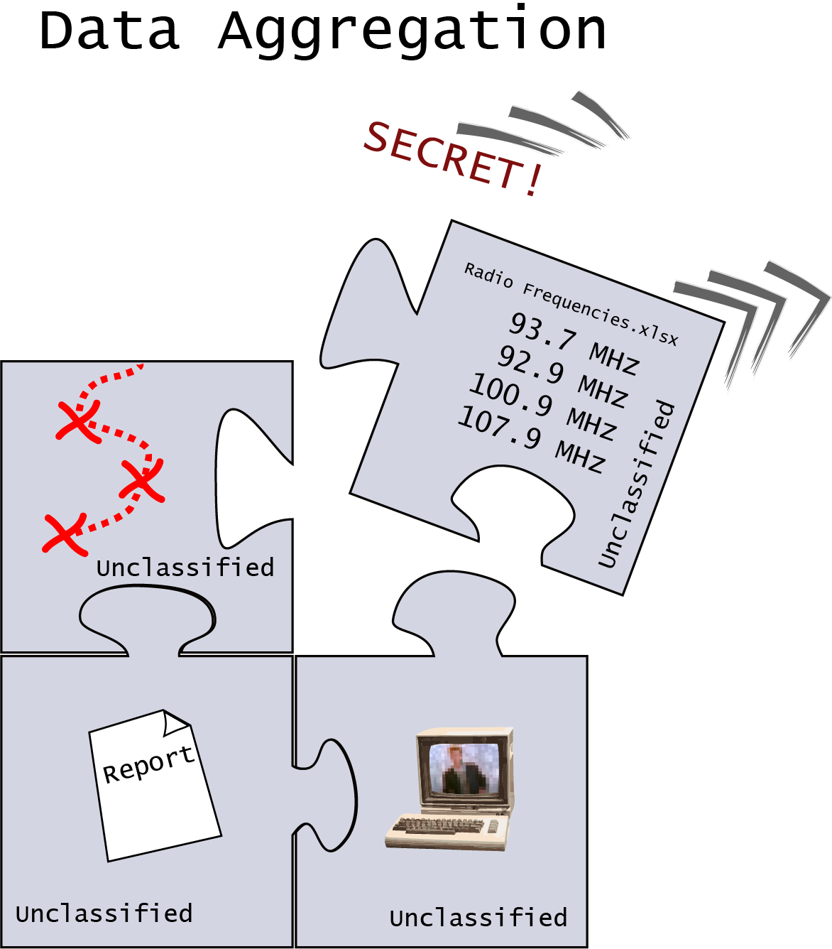
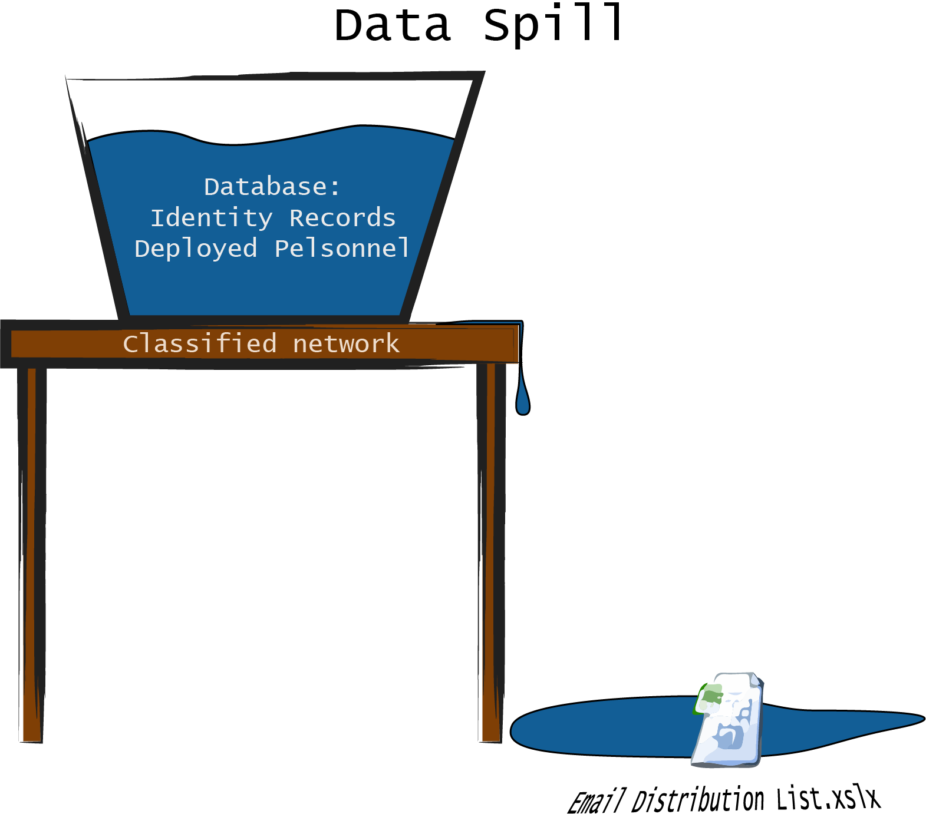
Data spills & aggregation issues
Important to be able to recognise the problems of data spills and aggregation:
Data spills – classified data existing on networks or devices that aren’t classified to handle the data
Data aggregation – multiple pieces of unclassified data, when combined can elevate the classification of the data.
Notes:
Defence have a more complicated data environment that most organisations. The potential for data to spill from one operation or system to another is a serious concern.
Data spills: Data existing where it shouldn’t.
For example: Inadvertently copied from a secure system, or accidentally found (a very likely scenario for an Incident Analyst)
A data spill can occur when data of a certain higher classification exists on a system or network that is not classified to handle that data
Data aggregation: Small pieces of data that can combine to elevate the classification of the data
For example: Individually, a map of a country, coordinates of ADF facilities, records of defence spending may not be classified. But, the existence of these data together could raise the classification of the data: Scenario: A map plus infrastructure coordinates, plus a purchase order for certain hardware, required by a certain date. This could valuable intelligence for an enemy organisations who can piece together the puzzle: “The following locations will have ___ specialised hardware installed by ___ date”
20

Slide 21
Notes:
21

